Slide 1
Belt Pulley
-By Rajendra Pulley Pedestal Centre

Slide 2
Business Concept
Rajendra Pulley is established by Mr. Rajendrabhai B. Panchal in 1993.
We provide our Pulley with complete Bore Key and Dynamic balancing, we are using different grade of material like GCI 15, GCI 20, GCI 25, SG 700/2, SG 600/3, SG 500/7, SG 400/2, also as per the customer requirement.
We are one of the prime leading Manufacturer, Supplier and Exporter of Belt Pulleys and Industrial Pulleys.
Every single product was designed and manufactured in our workshop and gone through a series of testing where expert technician checks properly and give affirmations as well as confirmation for such tools, hardware, and furthermore to fulfil every single global standard.
We are well-known in this market for offering good quality and our customers are satisfied fully

Slide 3
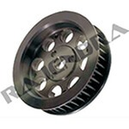
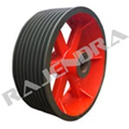
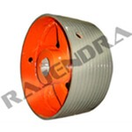
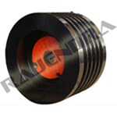
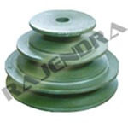
Belt Pulley Overview
Belt Pulley mainly used to to increase or decrease speed or rotation, as well to transfer power from one shaft to another.
The Pulley is the small wheel like structure that makes the use of the rope or belts or the chain like structures that is fixed in the grooves of the pulleys and are responsible for its movements.
Our Product
Timing Belt Pulley
V Belt Pulley
Flat Belt Pulley
Taper Lock Pulley
Variable Belt Pulley

Slide 4
Features of the Belt Pulley
The superior quality of the pulley is manufactured by us.
Free from the manufacturing defects.
It remains rust free.
They possess the longer shelf life.
It can be operable easily without any interruption.
Very easy to install and operates.

Slide 5
Application
In automotive engines
stationary power generators
marine engines
aviation engines
air compressor engines
agricultural equipment
chemical plant,
paper mill machines
plastic machinery
ceramic plant
paint industries

Slide 6

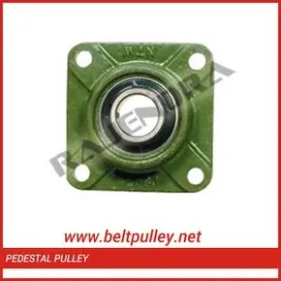
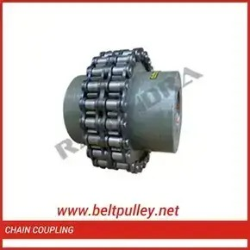

Industrial Belt Pulley
Gear Pulley
Pedestal Pulley
Chain Coupling
Chain Sprocket

Slide 7
Why choose Us?
The Best Quality Pulley is provided by us.
The wide range of the products are supplied by us that also at the affordable price.
After passing different quality standard are handed to the customers and hence they are free from the manufacturing defects.
The very fast and the secure delivery of the product is provided, no matter wherever you are situated we will reach you.
The fine grade raw materials used in their manufacturing that makes the pulley to possess the longer shelf life.
The products is provided by us are reasonable price and top in market.

Slide 8
People Also Search For
Pulley Manufacturer
Belt Pulley
Belt Pulley Manufacturer
Belt PulleySupplier
Belt Pulley Exporter
Belt Pulley Manufacturer in Ahmedabad
Industrial Belt Pulleys
Industrial Pulleys and Gears
V Belt Pulley
Taper Lock Pulley
Timing Pulley
Taper Lock Pulley

Slide 9

Contact Us
Address:
108, 109, Malav Estate,
Nr. S.B.I., Nagarwel Hanuman Road,
Rakhial, Ahmedabad-380026,
Gujarat, India.
Quick Contact:
+91-79-2274 0211
+91-98253 46044
Email:
info@rajendrapulley.com
Website:
www.beltpulley.net
Thank you

